Slide 1
THE DUAL CAPACITY-BUILDING FRAMEWORK FOR FAMILY-SCHOOL PARTNERSHIPS
DR. KAREN L. MAPP
Harvard Graduate School of Education

Slide 2
Definition of Family Engagement
The various ways that a child’s adult caretaker (biological parents, foster parents, siblings, grandparents, etc.), at home, school or in the community, effectively support children’s learning and healthy development.

Slide 3
Family Involvement versus Family Engagement
The latin root of the word "involvement" is “involvere” which means to wrap around, cover or envelop; roll, cause to roll.
The latin root of the word "engagement" is “engare” which means to make a formal agreement, to contract with; to pledge; an obligation to do something.

Slide 4
Impact of Family Engagement Students with Engaged Families:
Exhibit faster rates of literacy acquisition
Earn higher grades and test scores
Enroll in higher level programs
Are promoted more and earn more credits
Adapt better to school and attend more regularly
Have better social skills and behavior
Graduate and go on to higher education

Slide 5
John Hopkins Evaluation 2015: Family Engagement Partnership (FEP) in Washington, DC
Students whose families received a home visit, one of the core strategies in the FEP, had 24 percent fewer absences than similar students whose families did not receive a visit.
These same students also were more likely to read at or above grade level compared to similar students who did not receive a home visit.

Slide 6
Organizing Schools for Improvement (2010)
Notes:
No longer last on the list

Slide 7
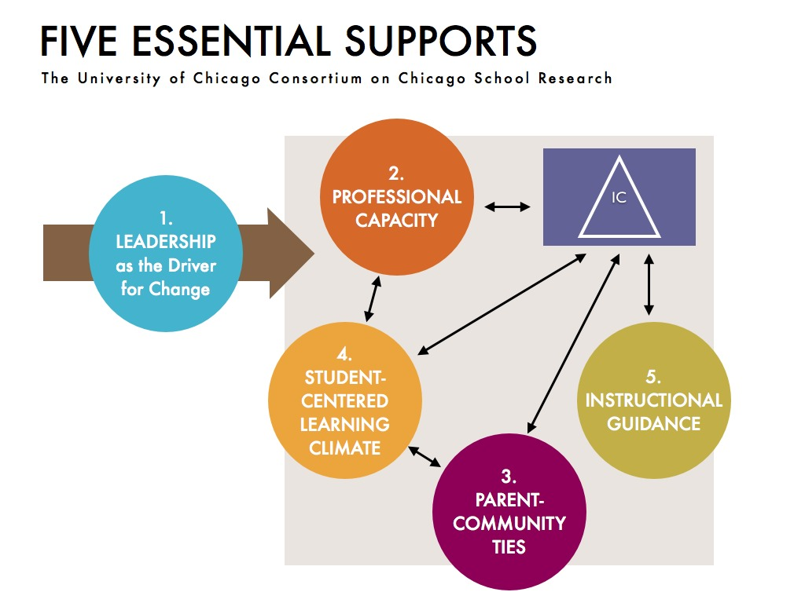

Slide 8
Impact on Teacher Retention
“In elementary schools, teachers perceptions of parents as partners in students’ education are strongly related to their decisions to remain in their school. Teacher-parent relationships account for much of the difference in stability rates between low-income African-American schools and other schools, and all of the difference are explained when we consider parent relationships along with other workforce conditions, including students behavior.”

Slide 9
What’s happening in the field of Family Engagement?
Increased philanthropic focus: Kellogg, Annie E. Casey, Packard
1100 people in attendance at the 2nd annual Family and Community Engagement Conference, Chicago, July 2015
Formation of the National Association for Family, School and Community Engagement (NAFSCE)
Over 130 districts are members of the Family Engagement District Leaders Group
Sold out Family Engagement institutes at Harvard
Inclusion of family engagement in state assessment and evaluation rubrics (For example, MA, NY, CT, CA OH)
Notes:
Mention what John King said last night at the Askwith Forum

Slide 10
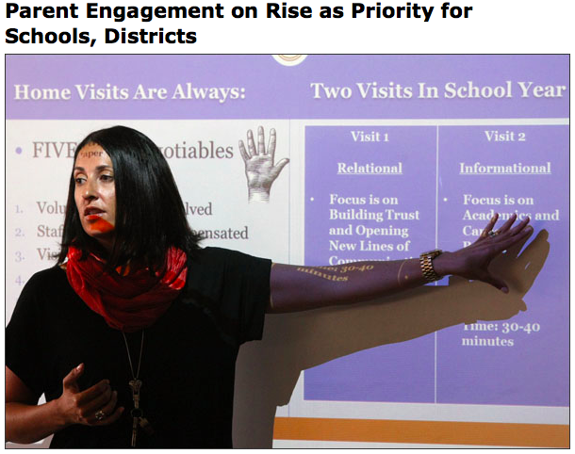
Ed Week Article- June 2015

Slide 11
Why has it been difficult to cultivate and sustain effective family-school partnerships that support student achievement and school improvement?

Slide 12
The various stakeholders (families, district/school leaders and staff) have not had the opportunity to develop the knowledge and skills, in other words, the capacity to engage in effective partnerships.

Slide 13
For Example:
Teachers state that engaging families in supporting their children’s education is one of the areas that they feel the least prepared when they start their careers - and their principals agree (MetLife Survey of the American Teacher, 2006).

Slide 14
Intention of the Framework
Instead of a roadmap, the framework provides a compass; a direction for the development of effective high impact strategies and initiatives.

Slide 15
Framework was formulated using:
Research on -
Effective home-school partnership strategies
Relational trust
Parent organizing
Adult learning and motivation
Leadership development

Slide 16
December 2012 Framework
Notes:
Received feedback from the field at a roundtable held in December 2012 at Stanton Elementary School.

Slide 17
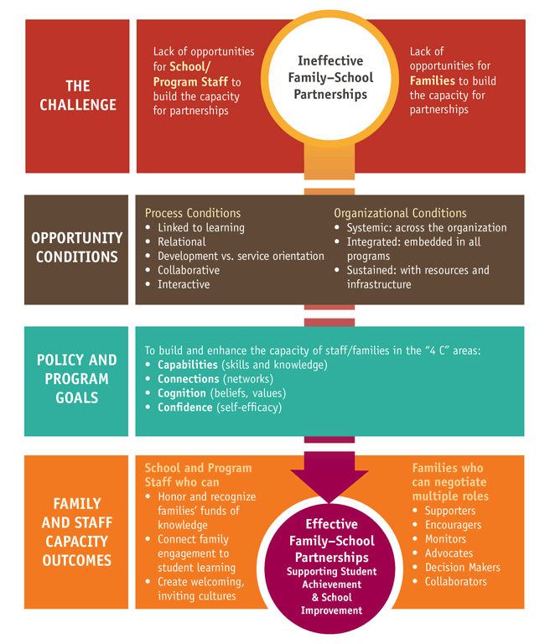

Slide 18
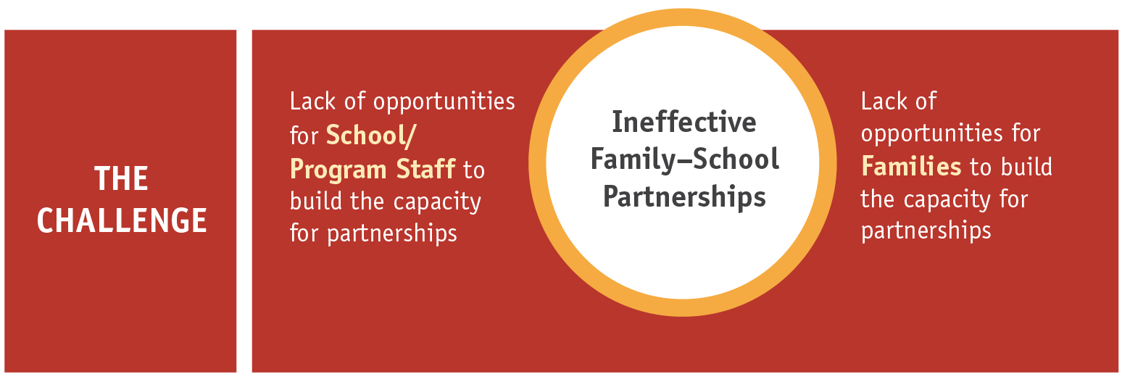
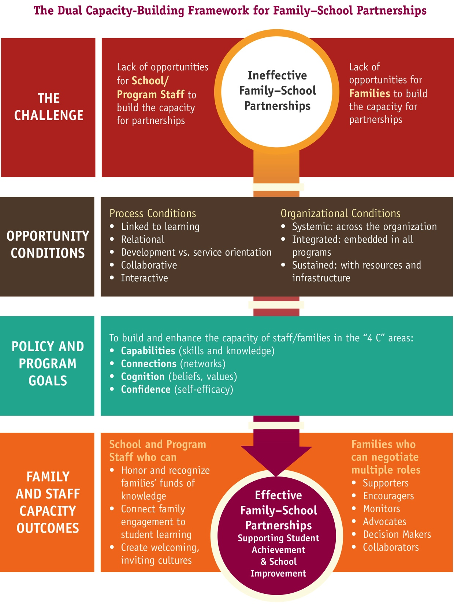

Slide 19
Notes:
This is the “how” of the work

Slide 20
Linked to Learning Exercise
List all of the events/activities that you currently have for families (think across the entire school year)
Circle all of the activities which fit the following criteria:
Families leave knowing more about what their child should know or be able to do (the learning goals) at that grade/age level -
They leave knowing how to employ a new tool or activity at home to support that learning goal

Slide 21
Notes:
This is the “how” of the work

Slide 22
Notes:
This is the what – what you can expect to see in terms of growth and changes in the adults that support the children

Slide 23
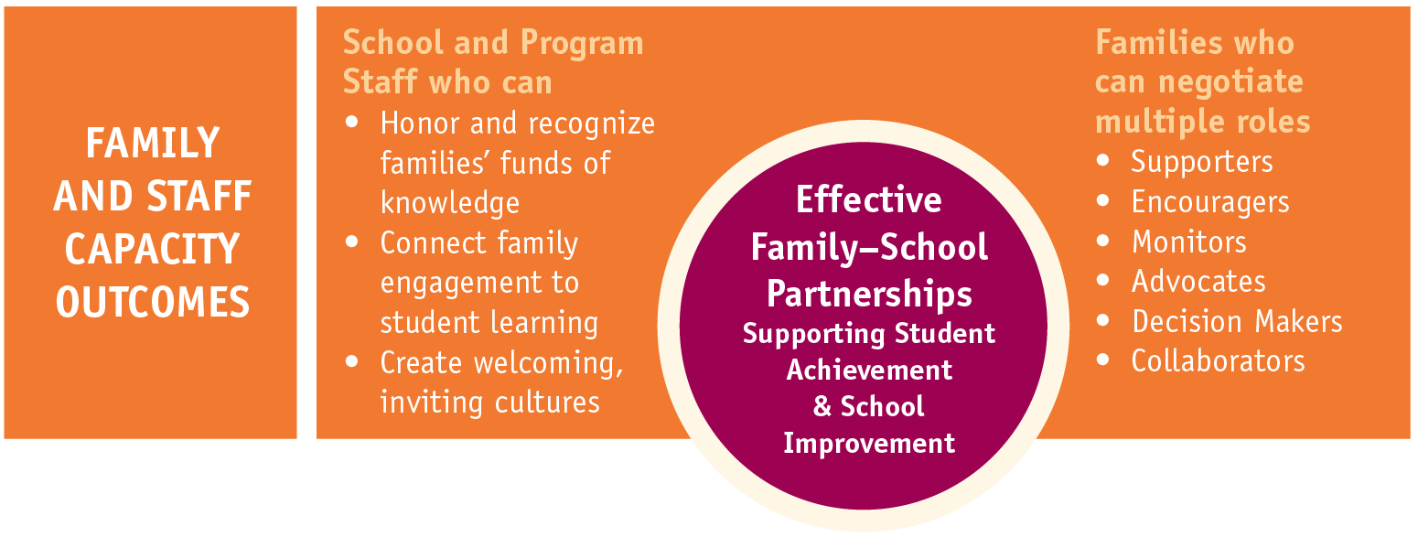

Slide 26
Example: Stanton Elementary School
Washington, DC

Slide 27
Video Debrief
What evidence do you see in the video of the five process conditions in the Dual Capacity framework?
Relational
Collaborative
Interactive
Developmental
Linked to Learning

Slide 28
What happens when we build respectful partnerships with families? A Parent’s Perspective

Slide 29
Requires a shift in mindset
From seeing family engagement as an add-on, extra work, a burden, or fundamentally separate from what we are supposed to do as educational practitioners...
…To seeing family engagement as an essential, fundamental component of proficient and effective teaching and learning practice.

Slide 30
Upcoming Events
IEL National Family and Community Engagement Conference, June 20-22, 2016
http://www.cvent.com/events/owning-our-movement-maximizing-our-impact/event-summary-3872b4dd0d3d4b60bd1861e61d3c572a.aspx
Harvard Professional Education Institute - Family Engagement in Education: Creating Effective Home and School Partnerships for Student Success, July 25-28, 2016
https://www.gse.harvard.edu/ppe/program/family-engagement-education-creating-effective-home-and-school-partnerships-student

Slide 31
Links
Summary of the Dual Capacity Framework:
www.scholastic.com/face/framework
Flamboyan Foundation Parent Video
https://www.youtube.com/watch?v=vbyhao0FtaQ&feature=youtu.be
Flamboyan APPT Video:
https://www.youtube.com/watch?v=1YNsWrFiYfY
Partners in Education:
http://www.sedl.org/pubs/framework/FE-Cap-Building.pdf

Slide 32
Join me on Twitter!
@karen_mapp

